Slide 1
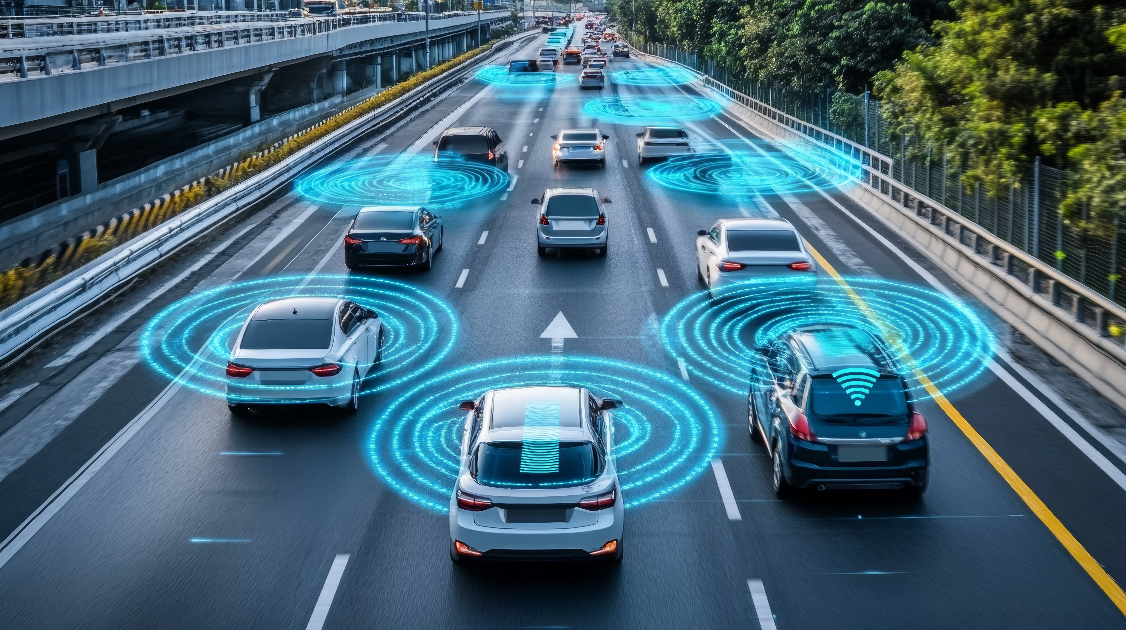



Guidance on Considering CAVs in Travel Demand Models (NCDOT RP 2023-11)
NCMUG Spring Meeting
Leta Huntsinger, PhD, PE | WSP
Si Shi, MCRP | ITRE

Slide 2

Research Goals
Investigate the consideration of Connected and Automated Vehicles (CAVs) in Travel Demand Models (TDMs) supported with case study analysis.
Develop guidelines that NCDOT and MPOs can use to inform the modification and application of TDMs to include CAVs.

Slide 3
Acknowledgements
Steering and Implementation Committee
Jaehoon Kim, Research Engineer
Research Team
Leta Huntsinger, Principal Investigator
Graphic Designer
Lisa Callister
Joe Hummer, Project Champion
Alena Cook
Keith Dixon
Tae-Gyu Kim
Travis Marshall
Si Shi
Fahim Kafashan
Ali Hajbabaie
Shoaib Samandar
Vince Bernardin
Kyle Ward

Slide 4
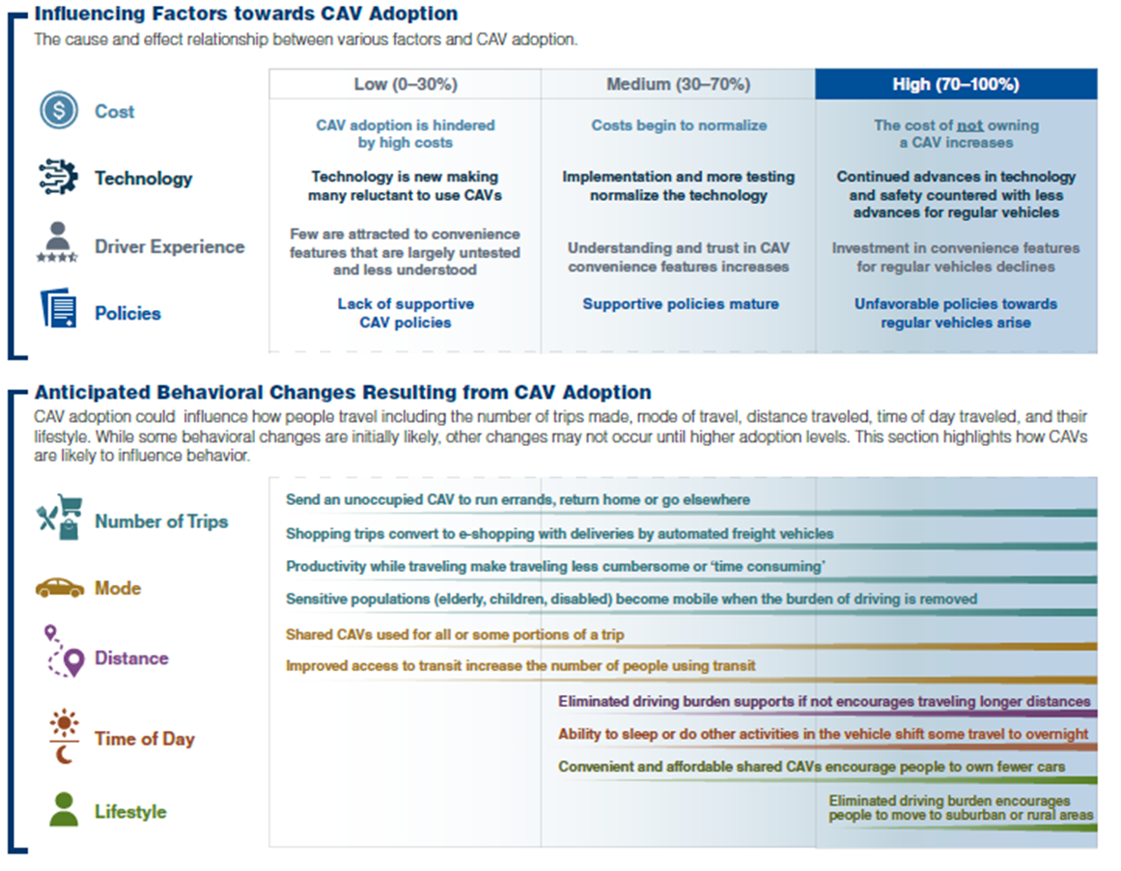
Index of Predictions and Factors

Slide 5
Strategic Scenario Planning
Approach
Case Study Evaluation
Findings & Recommendations
Q & A

Slide 6
Strategic Scenario Planning

Slide 7
Strategic Scenario Planning
Provides an analytical framework and process for understanding complex issues and responding to change
Facilitates consensus building by giving communities the capacity to participate actively in planning
Includes tools and techniques to assess the impact of transportation and other public policy choices on a community
Allows the opportunity to recognize the impact of tradeoffs among competing goals
Research driving forces
Determine patterns of interaction
Create scenarios
Analyze implications
Evaluate scenarios
https://highways.dot.gov/public-roads/septemberoctober-2005/scenario-planning

Slide 8
Approach

Slide 9
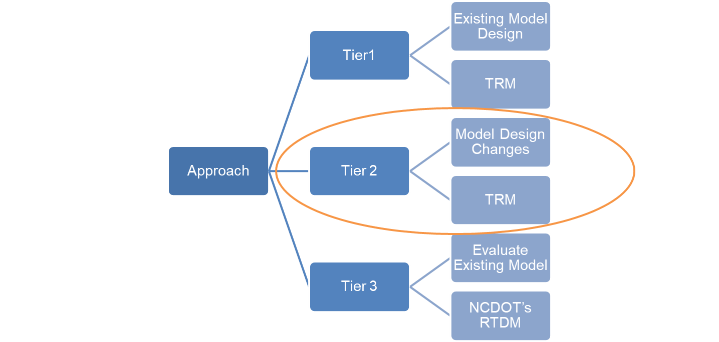
Multi-Tiered Approach

Slide 10
Approach: Tier 1
Existing Model Design

Slide 11
Adjust Existing Model Parameters
Parameter Adjustment | Sub-category | Scenarios
 |  | Medium-High (70%) | High (95%)
Value of Time | All people¹ | -60% | -65%
Trip rates | All purposes² | 9% | 15%
Highway Capacity | Signalized arterial | 40% | 70%
 | Control access facility | 47% | 77%
¹ The reduction applied in the model reflects the recommended reduction multiplied by the expected CAV adoption rate for the scenario. For medium-high scenario, VOT should be reduced by 42% (60%*70%).
²The adjustment captures additional trips resulting from ease of travel with CAVs, increased accessibility for elderly and disabled people, and empty trips from car sharing among household members.

Slide 12
Approach: Tier 2
Model Design Changes

Slide 13
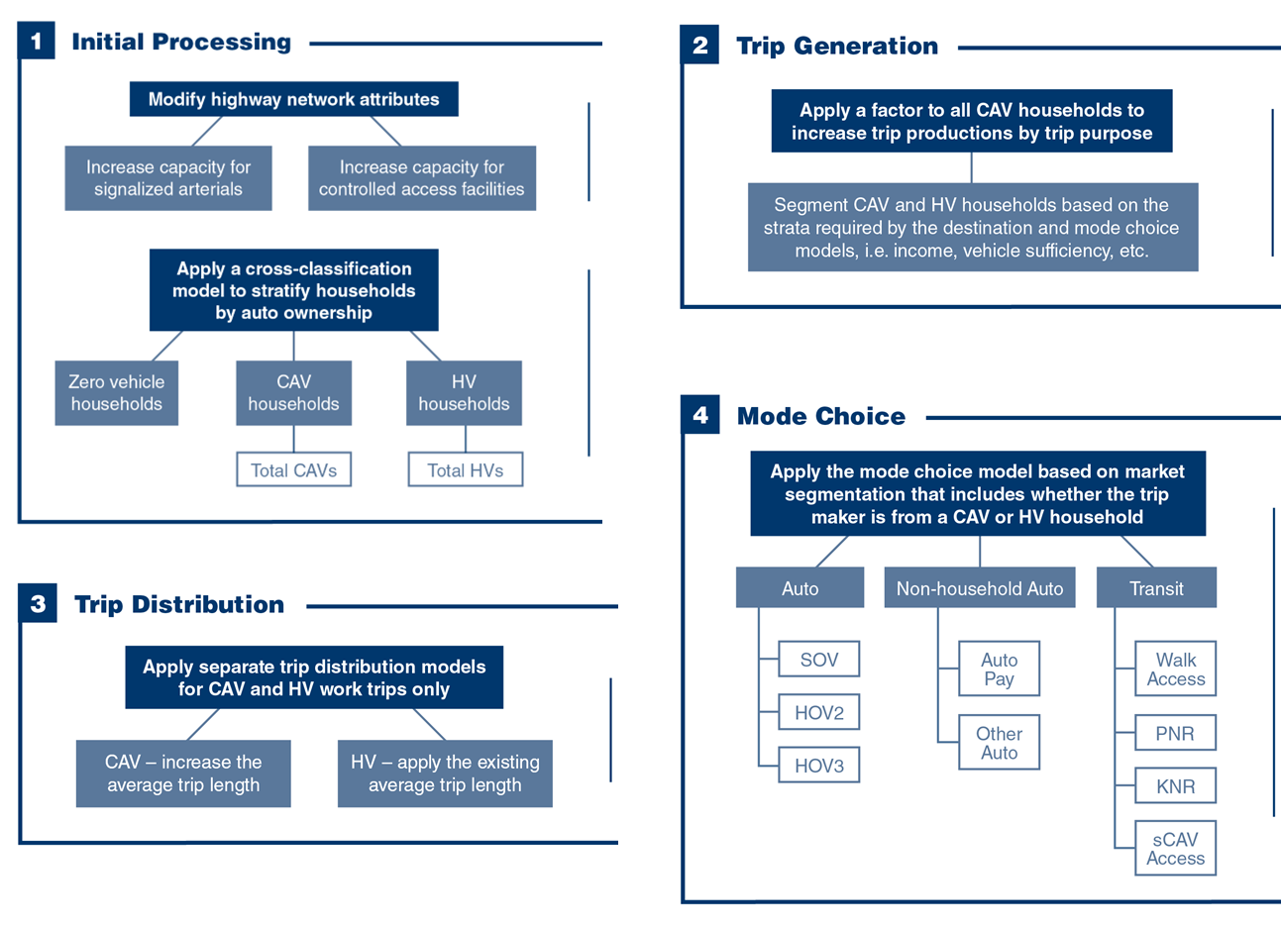
Conceptual Framework

Slide 14
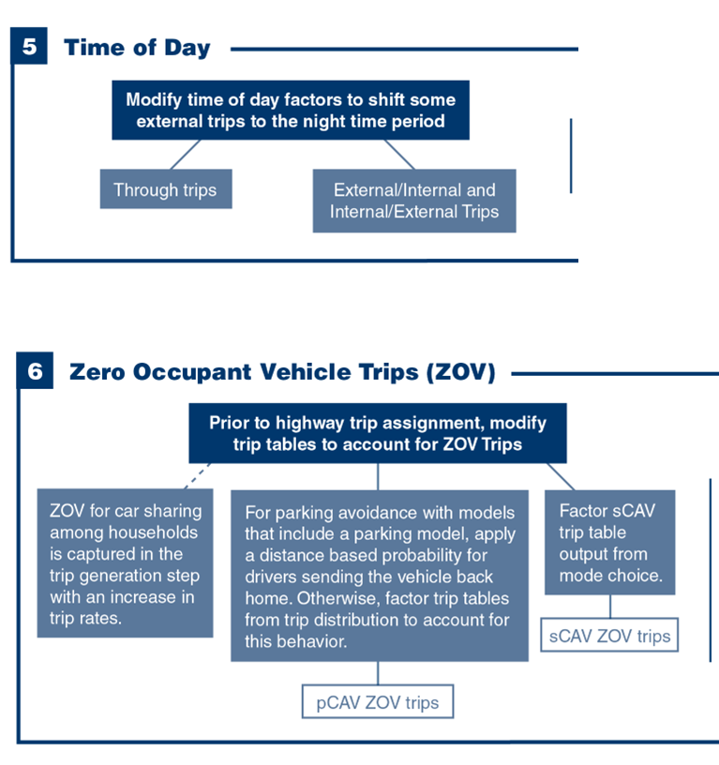
Conceptual Framework

Slide 15
Approach: Scenario Development
Tier 2 - Model Design Changes

Slide 16
Model Design
* Trip purpose specific

Slide 17
Performance Measures
System Level
Average trip length by purpose
Project Level
Demand
Vehicle miles traveled (total and congested)
Delay
Capacity
Demand-to-capacity ratio
Daily delay
Daily delay per mile

Slide 18
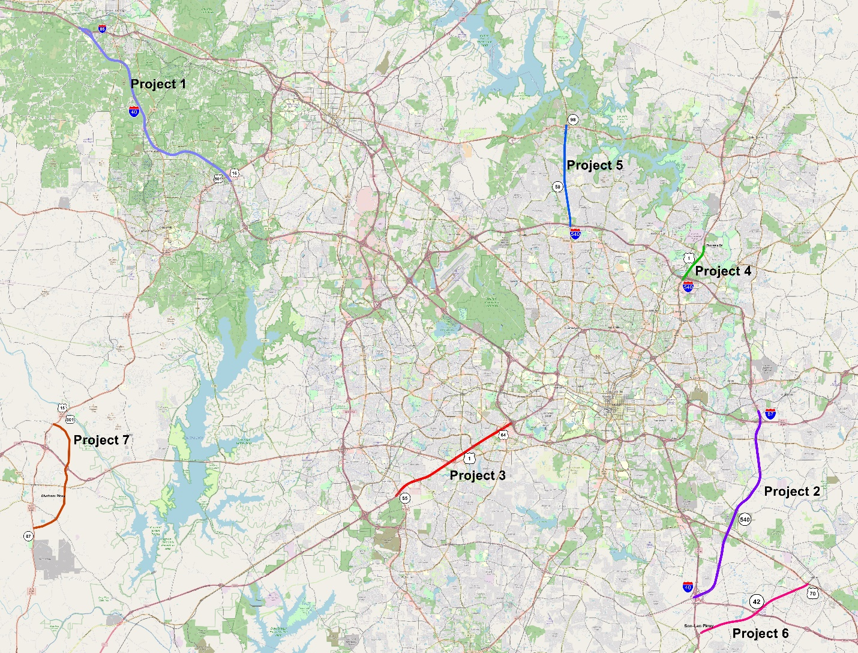
P# | Facility Type | Project Type | Roadway Name
1 | Interstate | Widening | I-40
2 | Freeway | New Location | NC 540
3 | Freeway | Widening | US 1
4 | Freeway | Widening | US 1
5 | Arterial | Widening | NC 50
6 | Arterial | Widening | NC 42
7 | Rural Roadway | New Location | Chatham Parkway

Slide 19
Case Study Evaluation

Slide 20
Evaluation Approach
Implement model design changes (model design scenario only)
Adjust parameters
Run model
2050 build – no CAVs
2050 build – CAVs (MH and H)
2050 no build – CAVs (focus on project level evaluation, MH only)
Summarize and evaluate results

Slide 21
Case Study Evaluation
TRM Model Design Results
System Level Metrics
Assumption: Level 5 automation

Slide 22
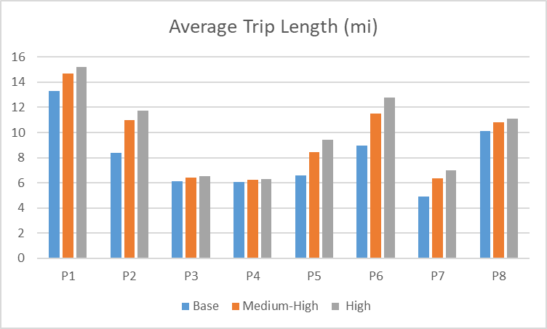
Trip Purposes
P1: Work tour
P2: Work tour – interim stop
P3: Work tour – drop kids at K12
P4: K12 trips
P5: Shop, dine, other trips
P6: Long duration discretionary trips
P7: Short duration discretionary trips
P8: Medical trips
CAVs lead to a longer average trip length (mi) for all trip purposes.
The biggest impact is for interim stops on a work tour and long duration discretionary trips, reflecting the influence of the changes in the asserted coefficients.
K-12 trips are least impacted by CAVs.

Slide 23
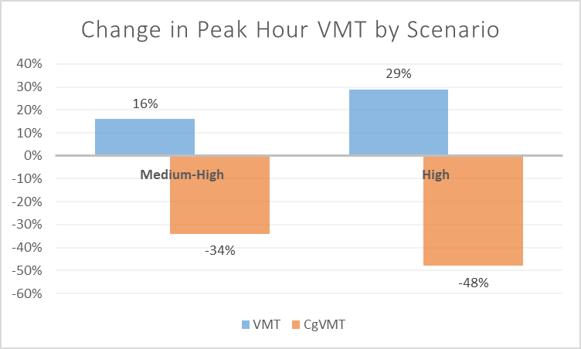
CAVs increase VMT with greater increases for the high scenario.
Overall VMT increases, but congested VMT decreases.
This is a direct reflection of the capacity benefits resulting from CAVs.

Slide 24
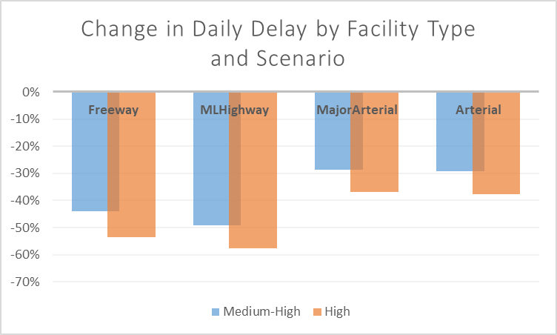
Delay decreases for all facility types, with the largest reductions in delay for freeways and multilane highways.
This is a direct reflection of the capacity benefits resulting from CAVs.

Slide 25
Case Study Evaluation
TRM Model Design Results
Project Level Metrics – Medium High CAV Scenario
Assumption: Level 5 automation

Slide 26
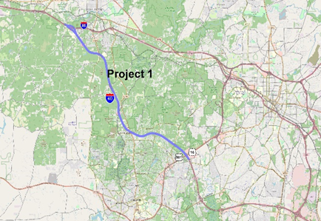
Project 1
I-40 Widening
 | Build No CAV | Build MH CAV | No Build MH CAV
Capacity | 12,329 | 18,124 | 12,083
Demand (peak hour) | 8,473 | 10,165 | 9,891
D/C | 0.69 | 0.56 | 0.82
Cost of delay per mile with project but no CAVs | $ 114
Cost of delay per mile with project and CAVs | $ 31
Savings | $ 82
Cost of delay per mile with CAVs but no project | $ 139
Loss | $ (26)
CAVs offer benefits in both the build and no build scenario.
The benefits of CAVs are like those seen when we build the project. Depending on the target D/C ratio, this could suggest delaying the project, but the presence of CAVs do not overcome the need for the project at MH adoption levels.

Slide 27
Project 3
US 1 Widening
 | Build No CAV | Build MH CAV | No Build MH CAV
Capacity | 12,277 | 18,048 | 12,032
Demand (peak hour) | 12,555 | 15,333 | 14,458
D/C | 1.02 | 0.85 | 1.20
Cost of delay per mile with project but no CAVs | $ 147
Cost of delay per mile with project and CAVs | $ 88
Savings | $ 59
Cost of delay per mile with CAVs but no project | $ 322
Loss | $ (175)
CAVs offer benefits in both the build and no build scenario.
The benefits of CAVs are not enough to overcome the need for the project.

Slide 28
Case Study Evaluation
Sensitivity Testing

Slide 29
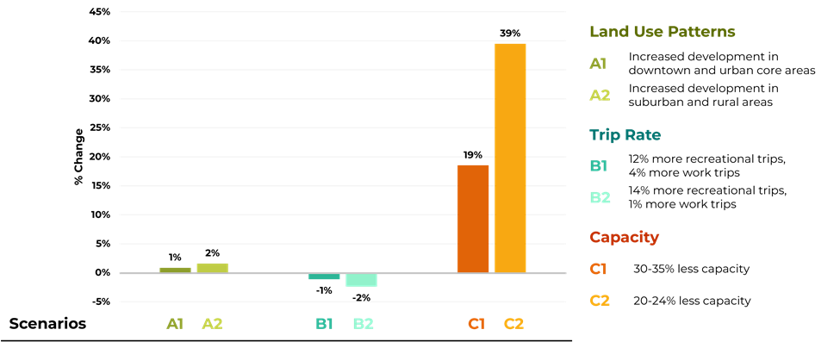
Project 1
I-40 Widening
Range of Uncertainty as Measured by Delay
The effect on system-level delay to changes in land use patterns and trip making is very small.
The capacity variable shows a higher degree of risk with a 40% higher measure of systems delay for the cautious capacity values.

Slide 30
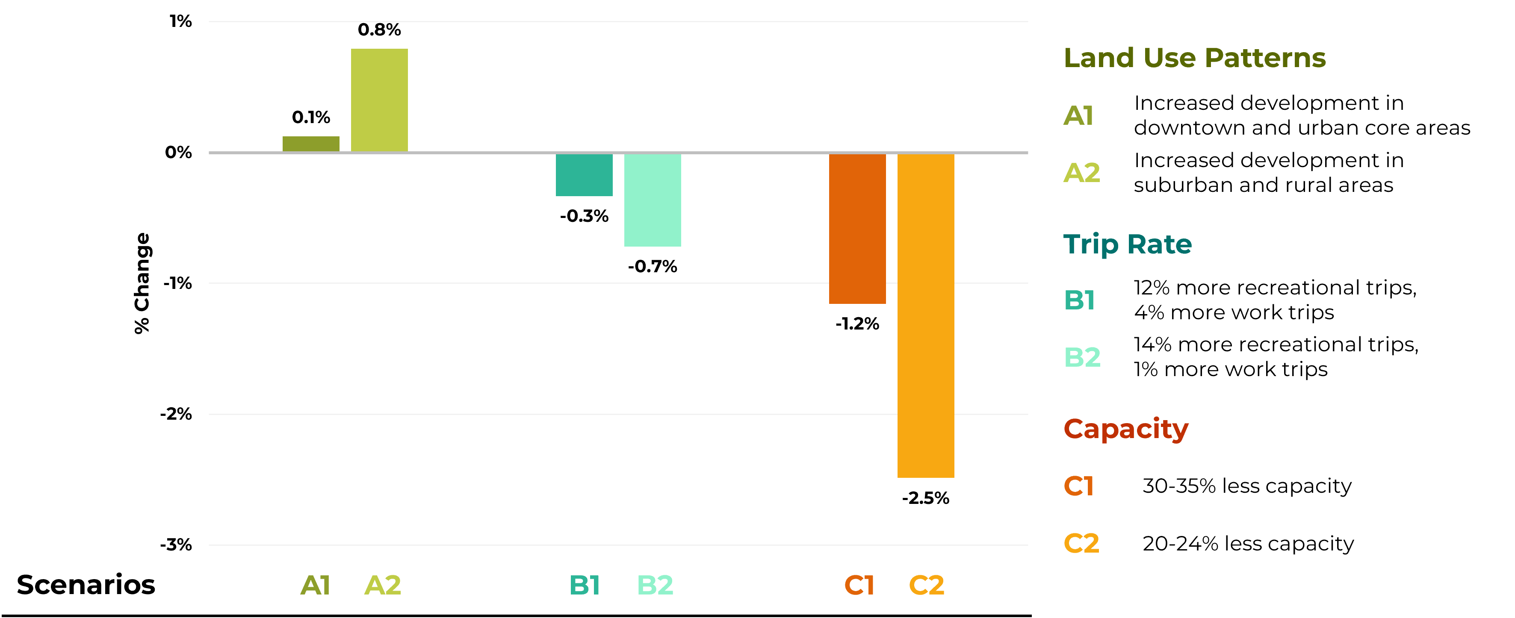
Project 1
I-40 Widening
Range of Uncertainty as Measured by Peak VMT
The effect on system level peak period VMT to changes in all variables is very small, suggesting lower levels of risk in the asserted values of these variables through the lens of systems level VMT.

Slide 31
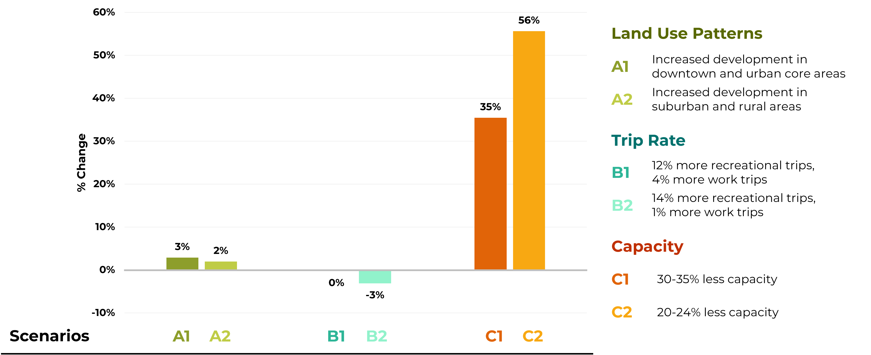
Project 1
I-40 Widening
Range of Uncertainty as Measured by Congested VMT
Peak period congested VMT shows a similar pattern as the daily delay.
Land use patterns and trip making having a small impact on congested VMT.
The degree of risk for the capacity variable is much higher.

Slide 32
Findings and Recommendations

Slide 33

Findings
Significant contribution to the use of travel models in a strategic scenario planning context to better understand the potential effects of CAVs.
The tiered approach lays a solid groundwork for changes that could be implemented immediately as well as those that require more time and effort but offer more behavioral realism.
This work informed the development of guidelines that can be used to incorporate findings into the models to better capture the effects of CAVs on long range transportation plans, project prioritization and project level traffic forecasts.

Slide 34
Recommendations
Immediately incorporate the consideration of CAVs in traffic forecasts and long-range transportation plans.
Incorporate model design changes for CAVs in future model development efforts.
Implement a regular practice of risk and uncertainty analysis.

Slide 35
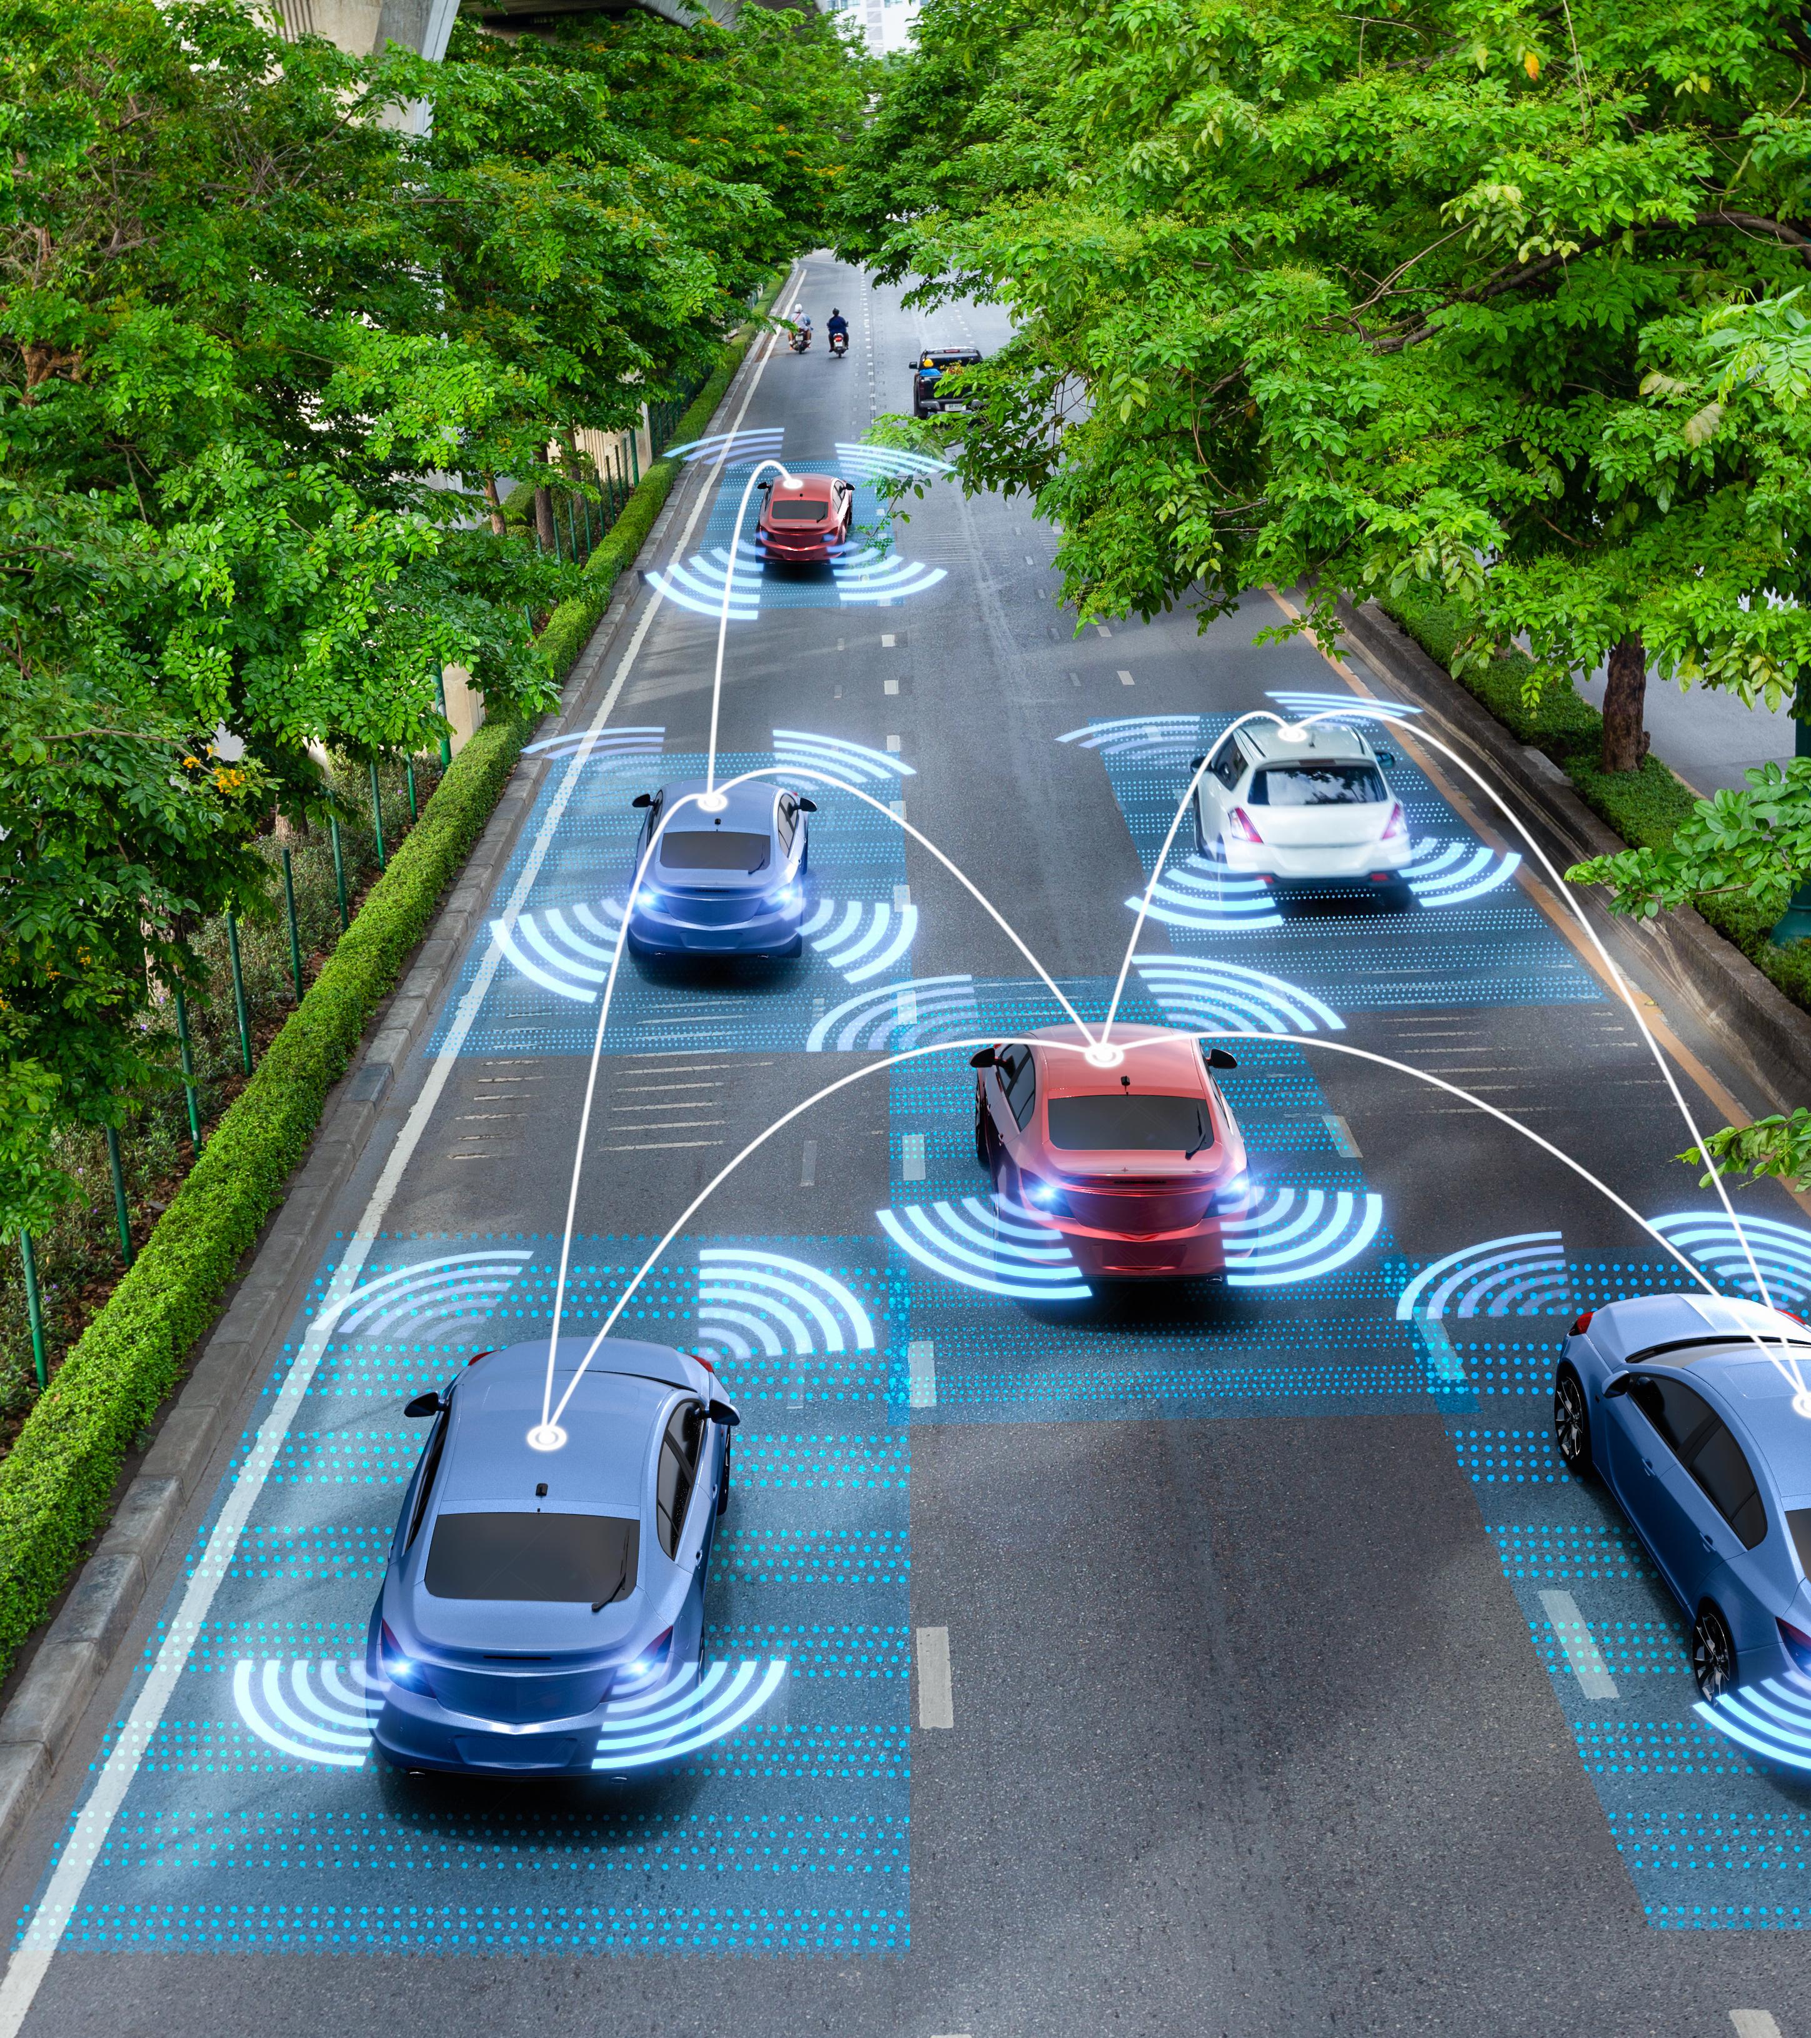
Thank You!

